Slide 1
Non Verbal Reasoning

Slide 2
1. Series completion 2. Classification 3.Water / Mirror images 4. Paper folding 5. Paper cutting 6. Embedded figures

Slide 3
1. Series Completion

Slide 4

Select a figure from amongst the Answer Figures which will continue the same series as established by the five Problem Figures.
Problem Figures: Answer Figures:
(A) (B) (C) (D) (E) (1) (2) (3) (4) (5)
A. 1
B. 2
C. 3
D. 4
5
Notes:
Ans: c

Slide 5

Select a figure from amongst the Answer Figures which will continue the same series as established by the five Problem Figures.
Problem Figures: Answer Figures:
(A) (B) (C) (D) (E) (1) (2) (3) (4) (5)
A. 1
B. 2
C. 3
D. 4
E. 5
Notes:
b

Slide 6

Problem Figures: Answer Figures:
(A) (B) (C) (D) (E) (1) (2) (3) (4) (5)
A. 1
B. 2
C. 3
D. 4
E. 5
Notes:
d

Slide 7

Select a figure from amongst the Answer Figures which will continue the same series as established by the five Problem Figures. Problem Figures: Answer Figures:
(B) (C) (D) (E) (1) (2) (3) (4) (5)
A. 1
B. 2
C. 3
D. 4
E. 5
Notes:
a

Slide 8

. Problem Figures: Answer Figures:
(A) (B) (C) (D) (E) (1) (2) (3) (4) (5)
A. 1
B. 2
C. 3
D. 4
E. 5
Notes:
b

Slide 9

Problem Figures: Answer Figures:
(A) (B) (C) (D) (E) (1) (2) (3) (4) (5)
A. 1
B. 2
C. 3
D. 4
E. 5
Notes:
a

Slide 10

Select a figure from amongst the Answer Figures which will continue the same series as established by the five Problem Figures. Problem Figures: Answer Figures:
(A) (B) (C) (D) (E) (1) (2) (3) (4) (5)
A. 1
B. 2
C. 3
D. 4
E. 5
Notes:
a

Slide 11

Problem Figures: Answer Figures:
(B) (C) (D) (E) (1) (2) (3) (4) (5)
A. 1
B. 2
C. 3
D. 4
E. 5
Notes:
d

Slide 12

Select a figure from amongst the Answer Figures which will
continue the same series as established by the five Problem Figures.
Problem Figures: Answer Figures:
(A) (B) (C) (D) (E) (1) (2) (3) (4) (5)
Notes:
D

Slide 13

Select a figure from amongst the Answer Figures which will continue the same series as established by the five Problem Figures. Problem Figures: Answer Figures: (A) (B) (C) (D) (E) (1) (2) (3) (4) (5)
Notes:
5

Slide 14
2. Classifications

Slide 15

Choose the figure which is different from the rest. A. 1 B. 2 C. 3 D. 4 E. 5
Notes:
1

Slide 16

Choose the figure which is different from the rest. A. 1 B. 2 C. 3 D. 4 E. 5
Notes:
3

Slide 17

Choose the figure which is different from the rest. A. 1 B. 2 C. 3 D. 4 E. 5
Notes:
1

Slide 18

Choose the figure which is different from the rest. (1) (2) (3) (4) (5)
Notes:
1

Slide 19
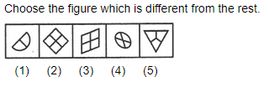
Notes:
4 , all other are divided into equal parts

Slide 20
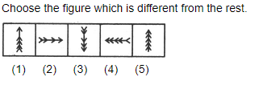

Slide 21
3. Water and Mirror Images

Slide 22
Same / Reverse Water Image: East –West / North- south Right-Left Top- bottom Mirror Image: North – South/ East – West Top-bottom Right - Left

Slide 23

Choose the alternative which is closely resembles the water-image of the given combination. A. 1 B. 2 C. 3 D. 4

Slide 24

Choose the alternative which is closely resembles the water-image of the given combination.
A. 1
B. 2
C. 3
D. 4

Slide 27

Choose the alternative which is closely resembles the water-image of the given combination.
Notes:
A

Slide 28

Choose the correct mirror image of the given figure (X) from amongst the four alternatives.
(X) (1) (2) (3) (4)
Notes:
d

Slide 29

Choose the correct mirror image of the given figure (X) from amongst the four alternatives.
(X) (1) (2) (3) (4)
Notes:
d

Slide 30

Choose the correct mirror image of the given figure (X) from amongst the four alternatives.
(X) (1) (2) (3) (4)
Notes:
C

Slide 31
4. Paper folding/ cutting

Slide 32

Find out from amongst the four alternatives as to how the pattern would appear when the transparent sheet is folded at the dotted line. A. 1 B. 2 C. 3 D. 4

Slide 33

Find out from amongst the four alternatives as to how the pattern would appear when the transparent sheet is folded at the dotted line. A. 1 B. 2 C. 3 D. 4

Slide 34
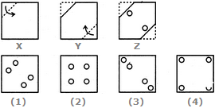

Slide 35
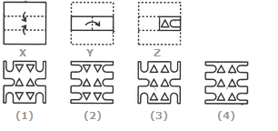
Choose a figure which would most closely resemble the unfolded form of Figure (Z). A. 1 B. 2 C. 3 D. 4

Slide 36
Embedded figures

Slide 37

Find out the alternative figure which contains figure (X) as its part.
(X) (1) (2) (3) (4)

Slide 38

Find out the alternative figure which contains figure (X) as its part.
(X) (1) (2) (3) (4)

Slide 39

Find out the alternative figure which contains figure (X) as its part.
(X) (1) (2) (3) (4)

Slide 40
Miscellaneous Questions

Slide 41
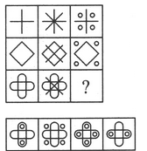
Select a suitable figure from the four alternatives that would complete the figure matrix.
1 2 3 4

Slide 42
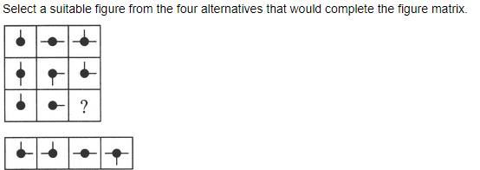
1 2 3 4

Slide 43
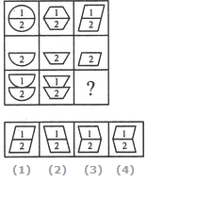
Select a suitable figure from the four alternatives that would complete the figure matrix.

Slide 44

Select the figure which satisfies the same conditions of placement of the dots as in Figure-X

Slide 45

Select the figure which satisfies the same conditions of placement of the dots as in Figure-X.

Slide 46
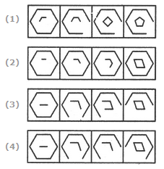
Choose the set of figures which follows the given rule. Rule: Closed figures losing their sides and open figures gaining their sides.

Slide 47
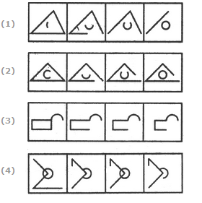
Choose the set of figures which follows the given rule. Rule: Closed figures become more and more open and open figures become more and more closed.

Slide 48
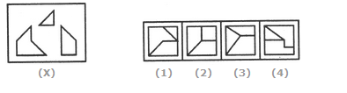
Find out which of the figures (1), (2), (3) and (4) can be formed from the pieces given in figure (X).

Slide 49
THANK YOU

